Slide 1
H.aHKBox Chassis
&
Hardware Interface Communications
Adam Stammer
Under the Direction of Dr. Carl Ferkinhoff

Slide 2
Define the Problem
Research
List Requirements
Brainstorm Solutions
Choose Solution
Develop Solution
Prototype
Test and Redesign
Communicate Results
Design Steps

Slide 3
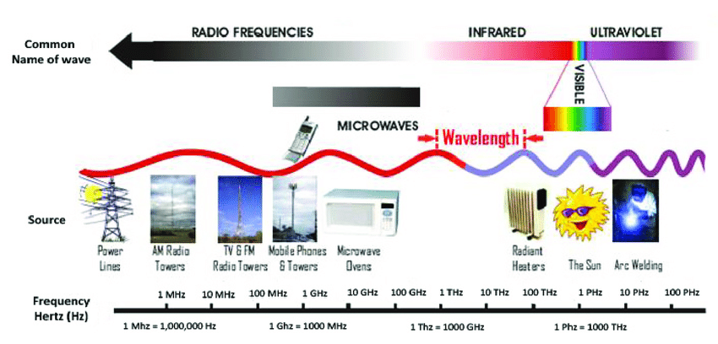
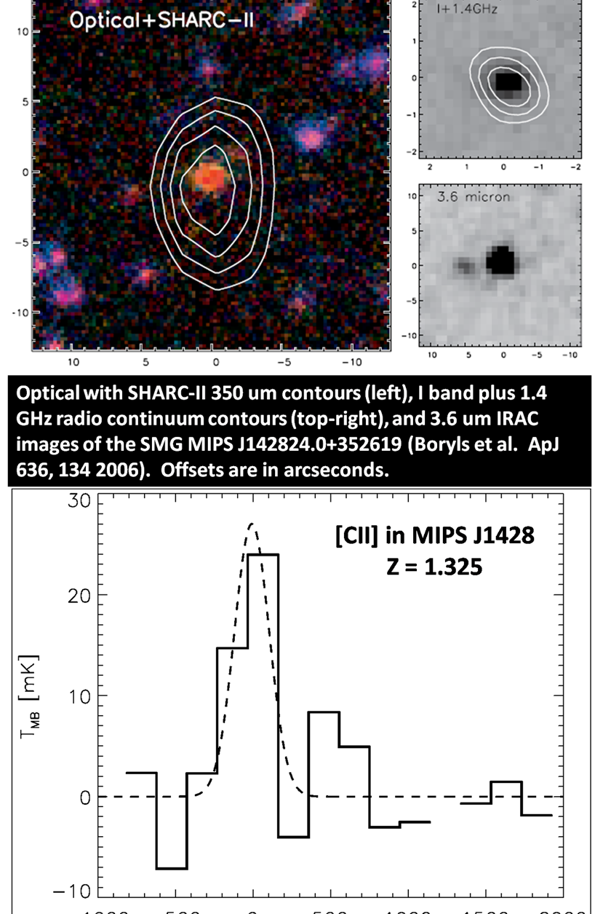
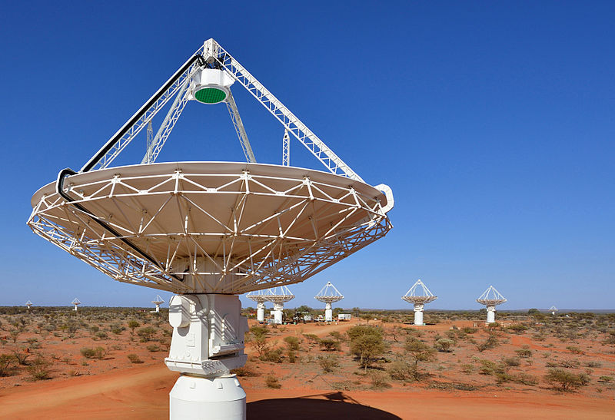
Radioastronomy

Slide 4
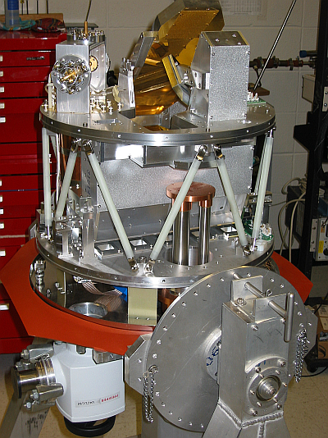
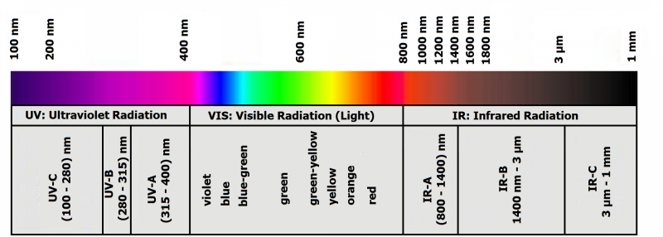
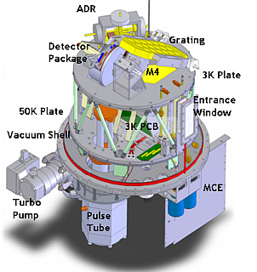
Designed by Dr. Carl Ferkinhoff (~2009)
Radio Telescope
Submillimeter grating spectrometer
Observer emission lines in all submillimeter bands accessible from the ground
What is ZEUS2?
Notes:
4

Slide 5
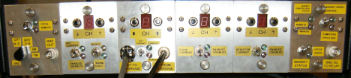
What’s the Problem?
Rather Old
No Longer Supported by Manufacturer
Superfluous
Clunky
Occasionally Malfunctioned

Slide 6
Abstract Goals
To design and build an open source, modular Eurocard system to be used as astronomical control/housekeeping equipment
To replace existing ZEUS2 housekeeping equipment with a cheaper, simpler, more robust system
Design Steps
Design Prototyping Daughtercard (P-Card)
Design Eurocard Backplane to connect and control modular cards
Choose Power Supplies
Choose Chassis
Manufacture
Program Embedded Controllers
The Project
Notes:
6

Slide 7
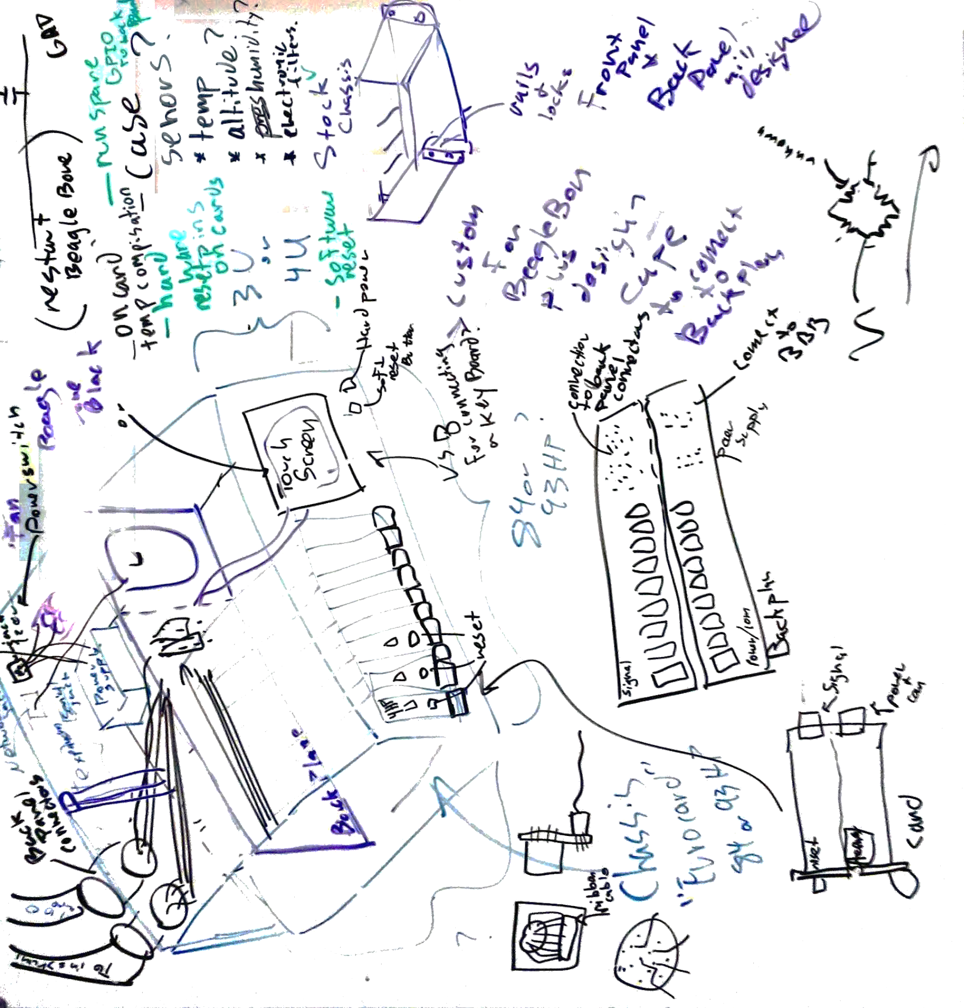
Whiteboarding of the H.aHK Box

Slide 8
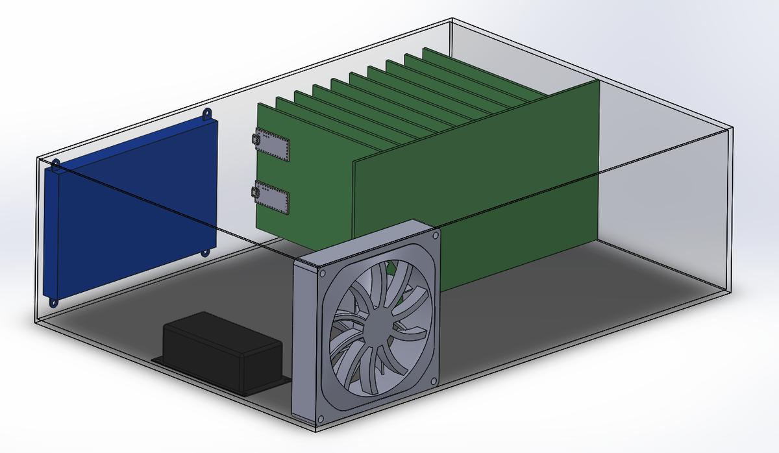
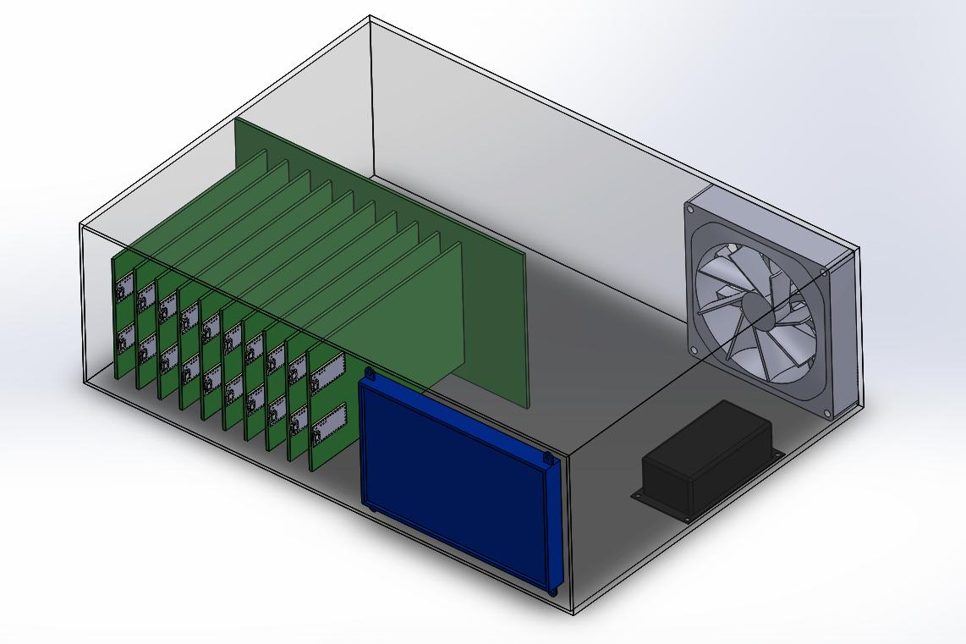
Draft model of H.aHK Box
Blue = touch screen
Black = power supply
Grey = cooling fan
Green = circuit boards (big is the bus, and slam are the cards)

Slide 9
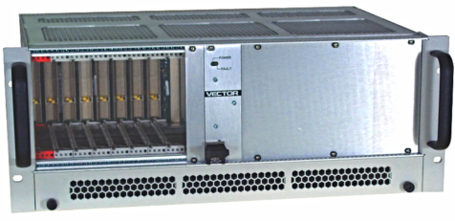
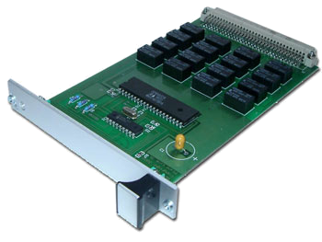
Device | Processor | RAM/ Storage | Other | Software | Ref.
Raspberry Pi 3 $39.95 | 64-bit 1.2 GHz ARM | 1 GB/ 32GB | 40GPIO, SPI, I2C, HDMI, 4 - USB, Ethernet, Serial | Debian Linux | [5]
Teensy 3.2 $19.80 | 72 MHz ARM Cortex-M4 | 64KB/ 256 KB | 34 GPIO, 21 ADC (13-Bit), Serial (3), SPI, I2C (2), | Arduino IDE | [6]
Similar cases and cards as the H.aHK Box as found commercially.

Slide 10
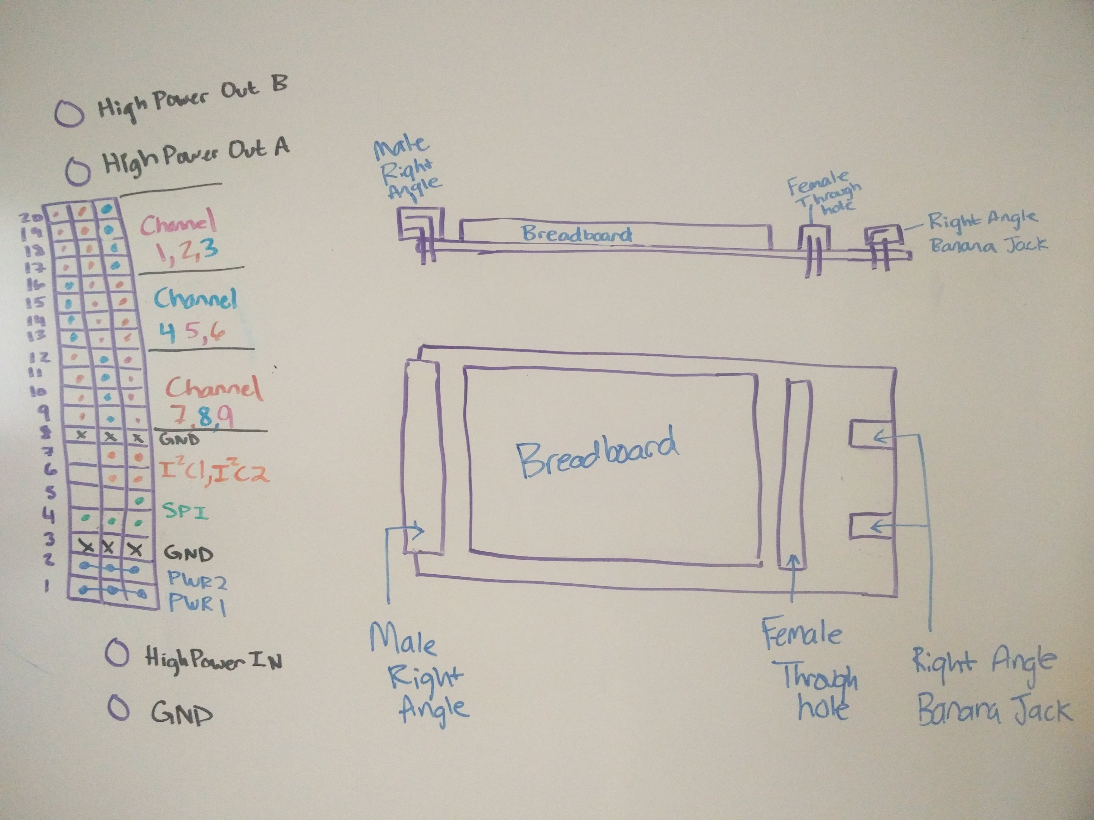
Male Socket, Female Socket, Breadboard, High Power Banana Jacks, Double Length For Easy Access
Prototyping Card (P-Card)
Sketch

Slide 11
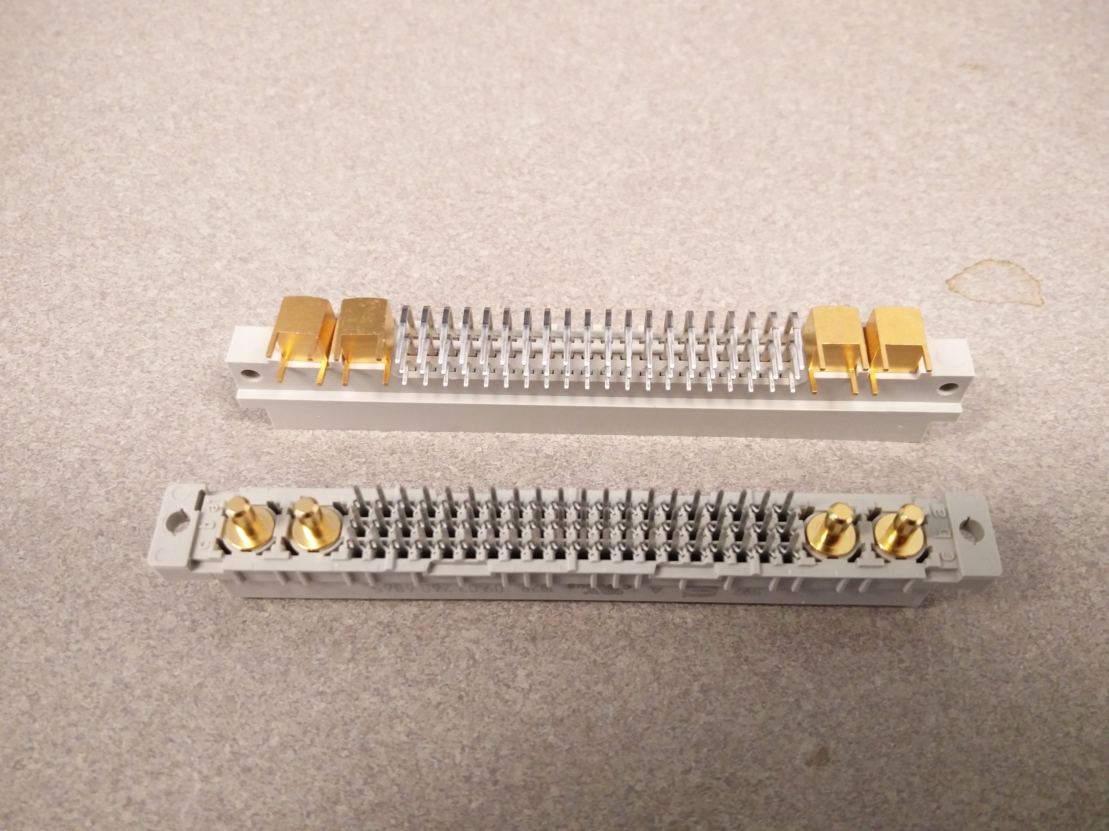
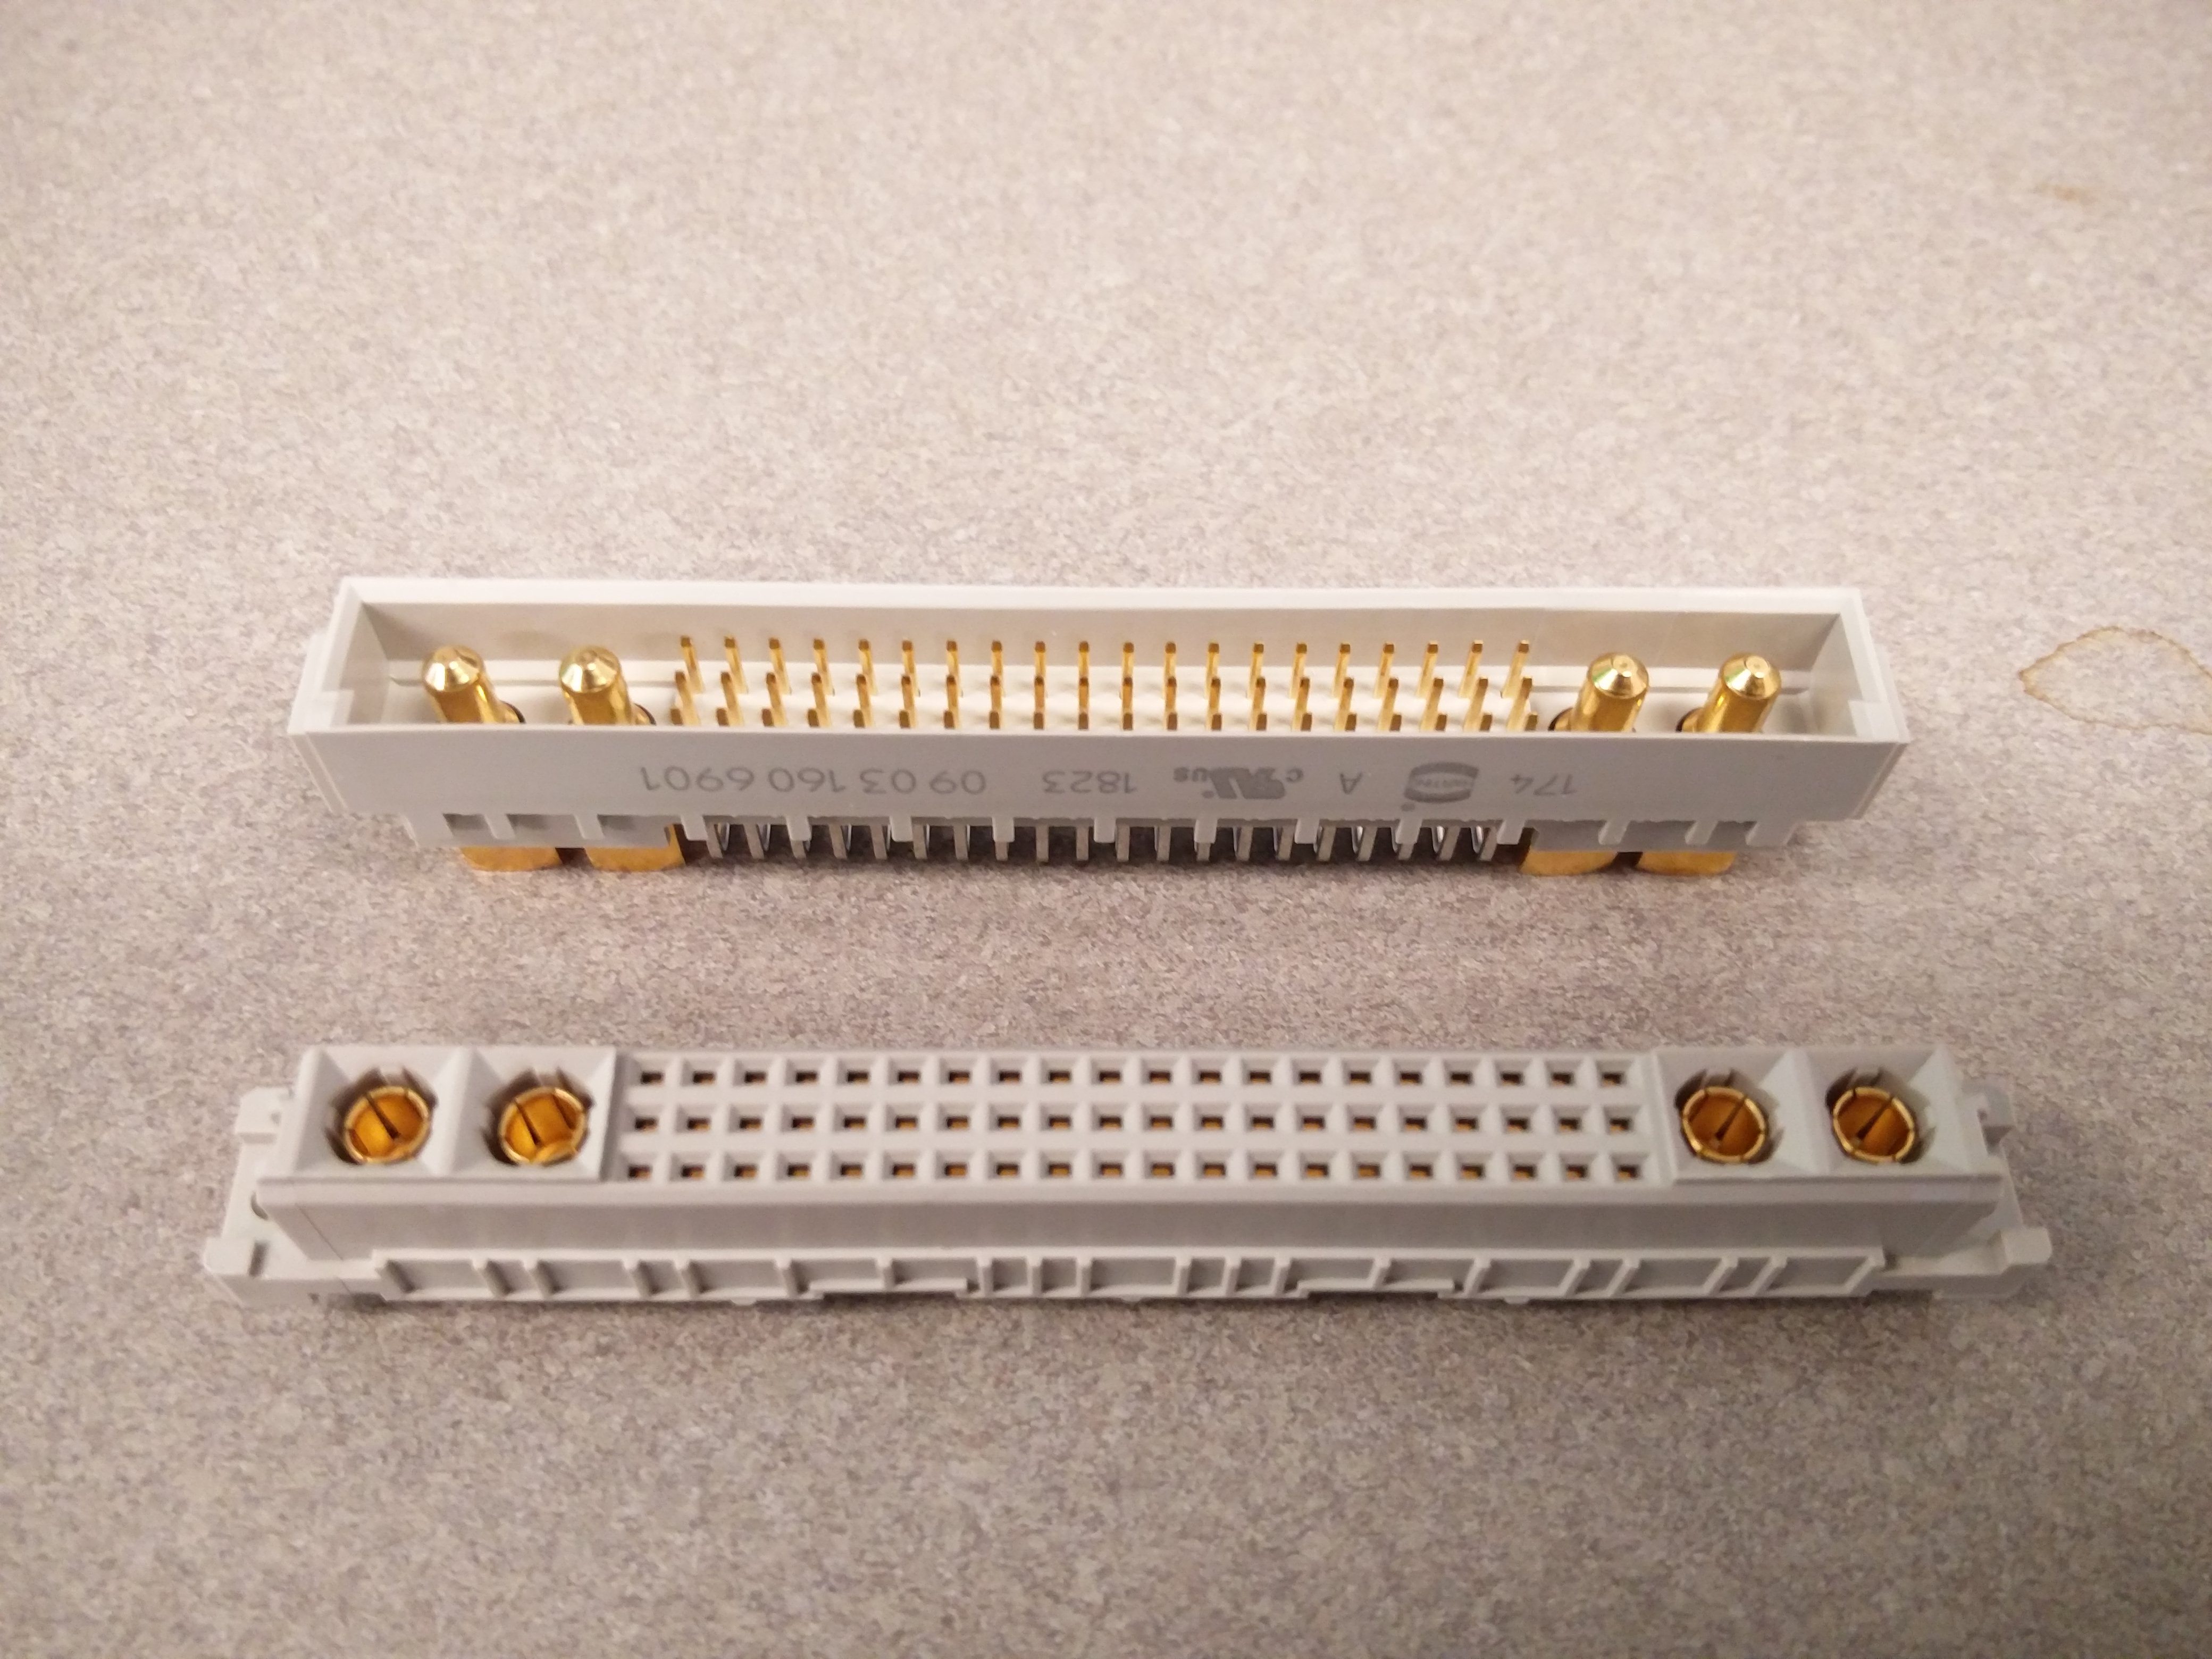
60 Pins @ 2 Amps and 4 High Current Pins @ 20 Amps
Sockets

Slide 12
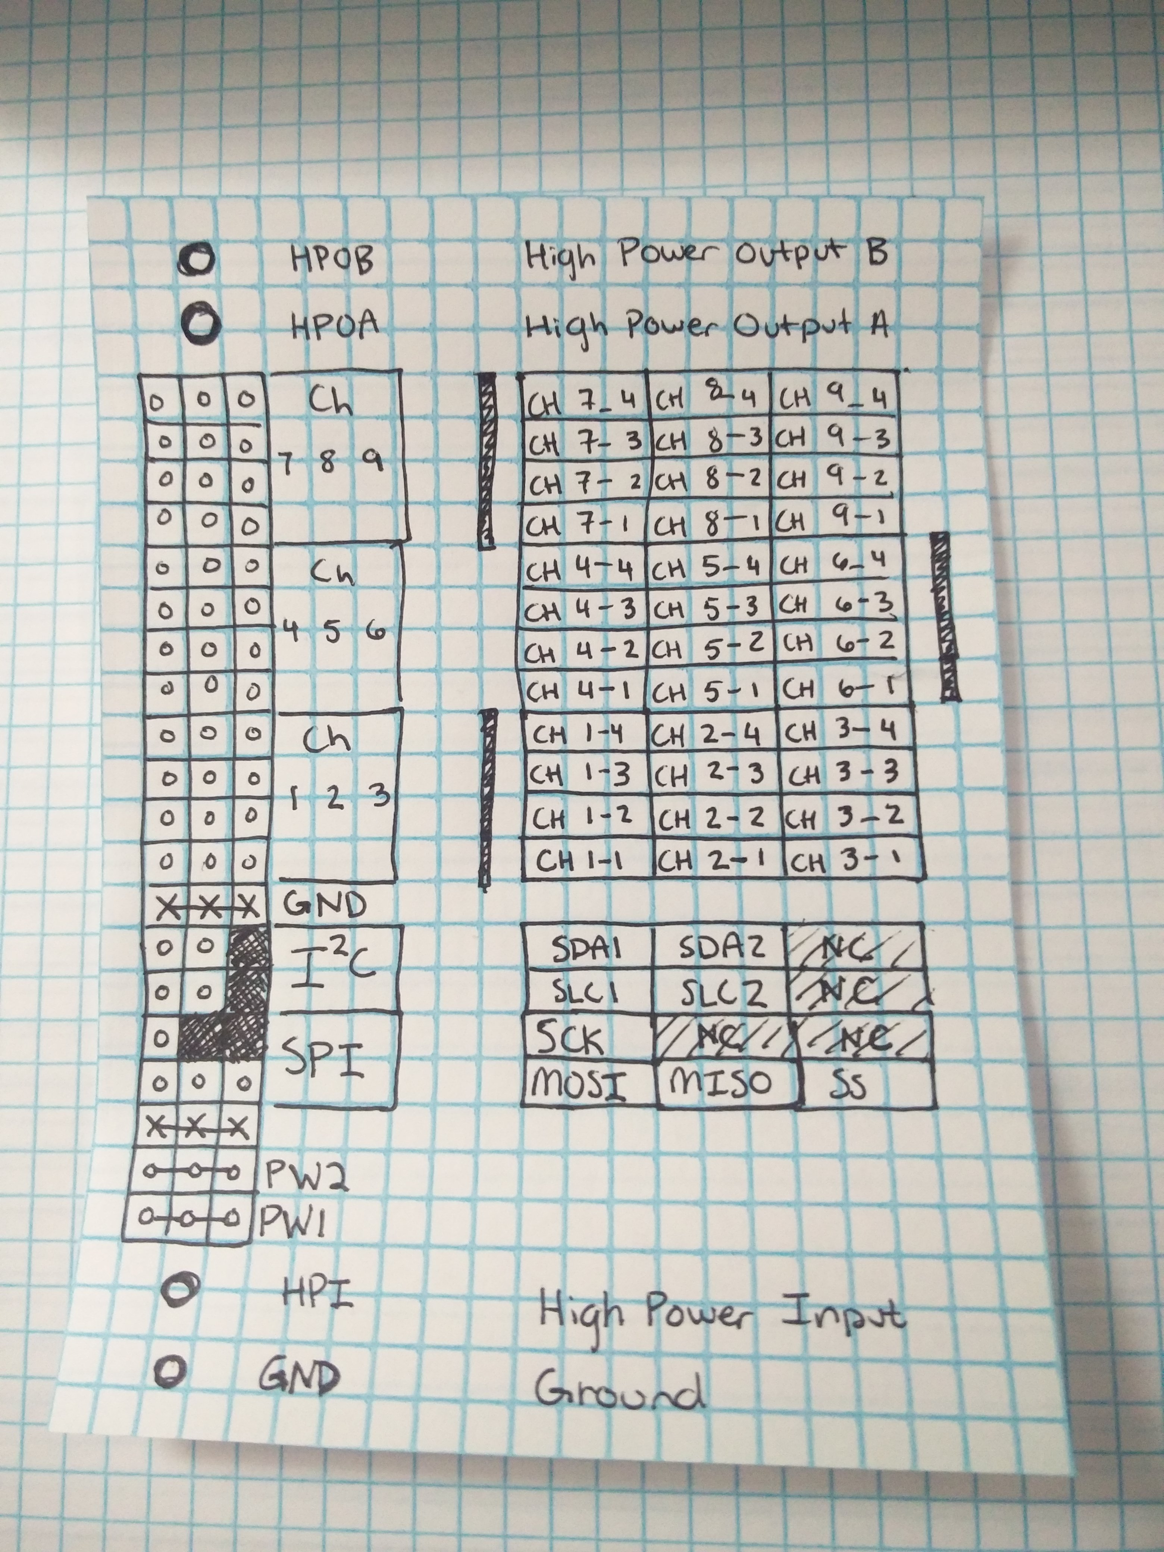
2 HP IO, 9 4pin IO Channels, 2 I2C Channels, 1 SPI Channel, Low Power Input, High Power Input, Ground
Socket Pinout

Slide 13
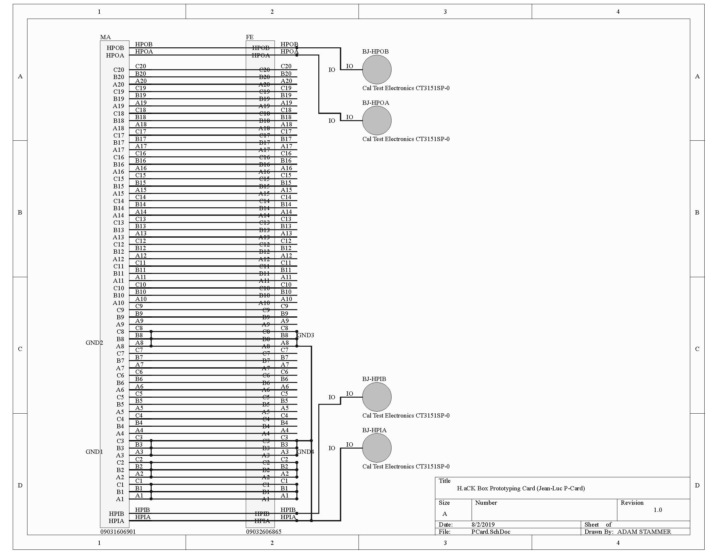
Male Socket, Female Socket, Breadboard, High Power Banana Jacks, Double Length For Easy Access
Prototyping Card (P-Card)

Slide 14
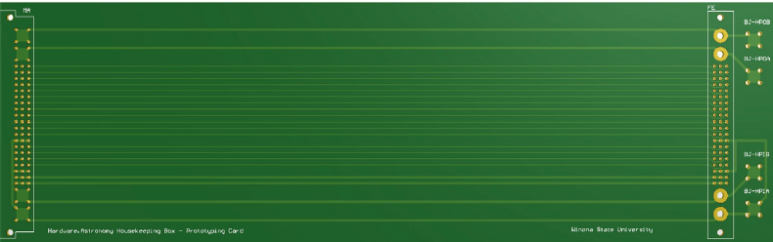
Male Socket, Female Socket, Breadboard, High Power Banana Jacks, Double Length For Easy Access
Prototyping Card (P-Card)

Slide 15
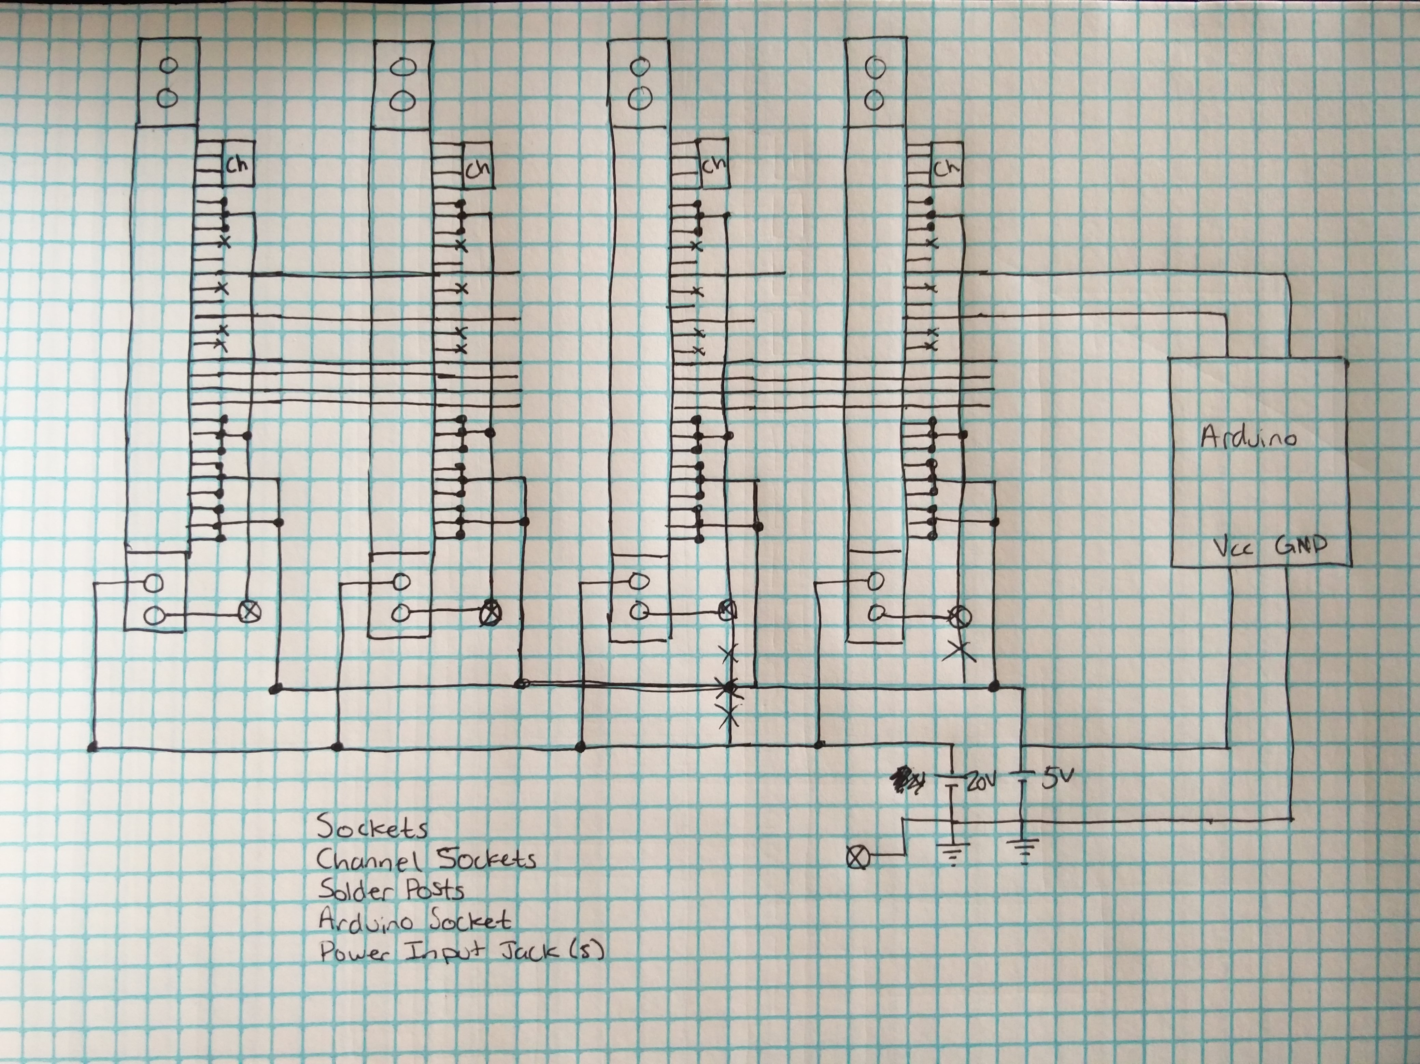
Sockets, Power, SPI, HP Signal I/O, 9 4-pin signal I/Os per card, Arduino Controller (with I2C), On board Temperature Sensors, 7-segment digit display, 5Volt and 20Volt Power, Raspberry Pi (with I2C), Interrupts from Arduino and Pi
Backplane
Simplified
Schematic
Sketch

Slide 16
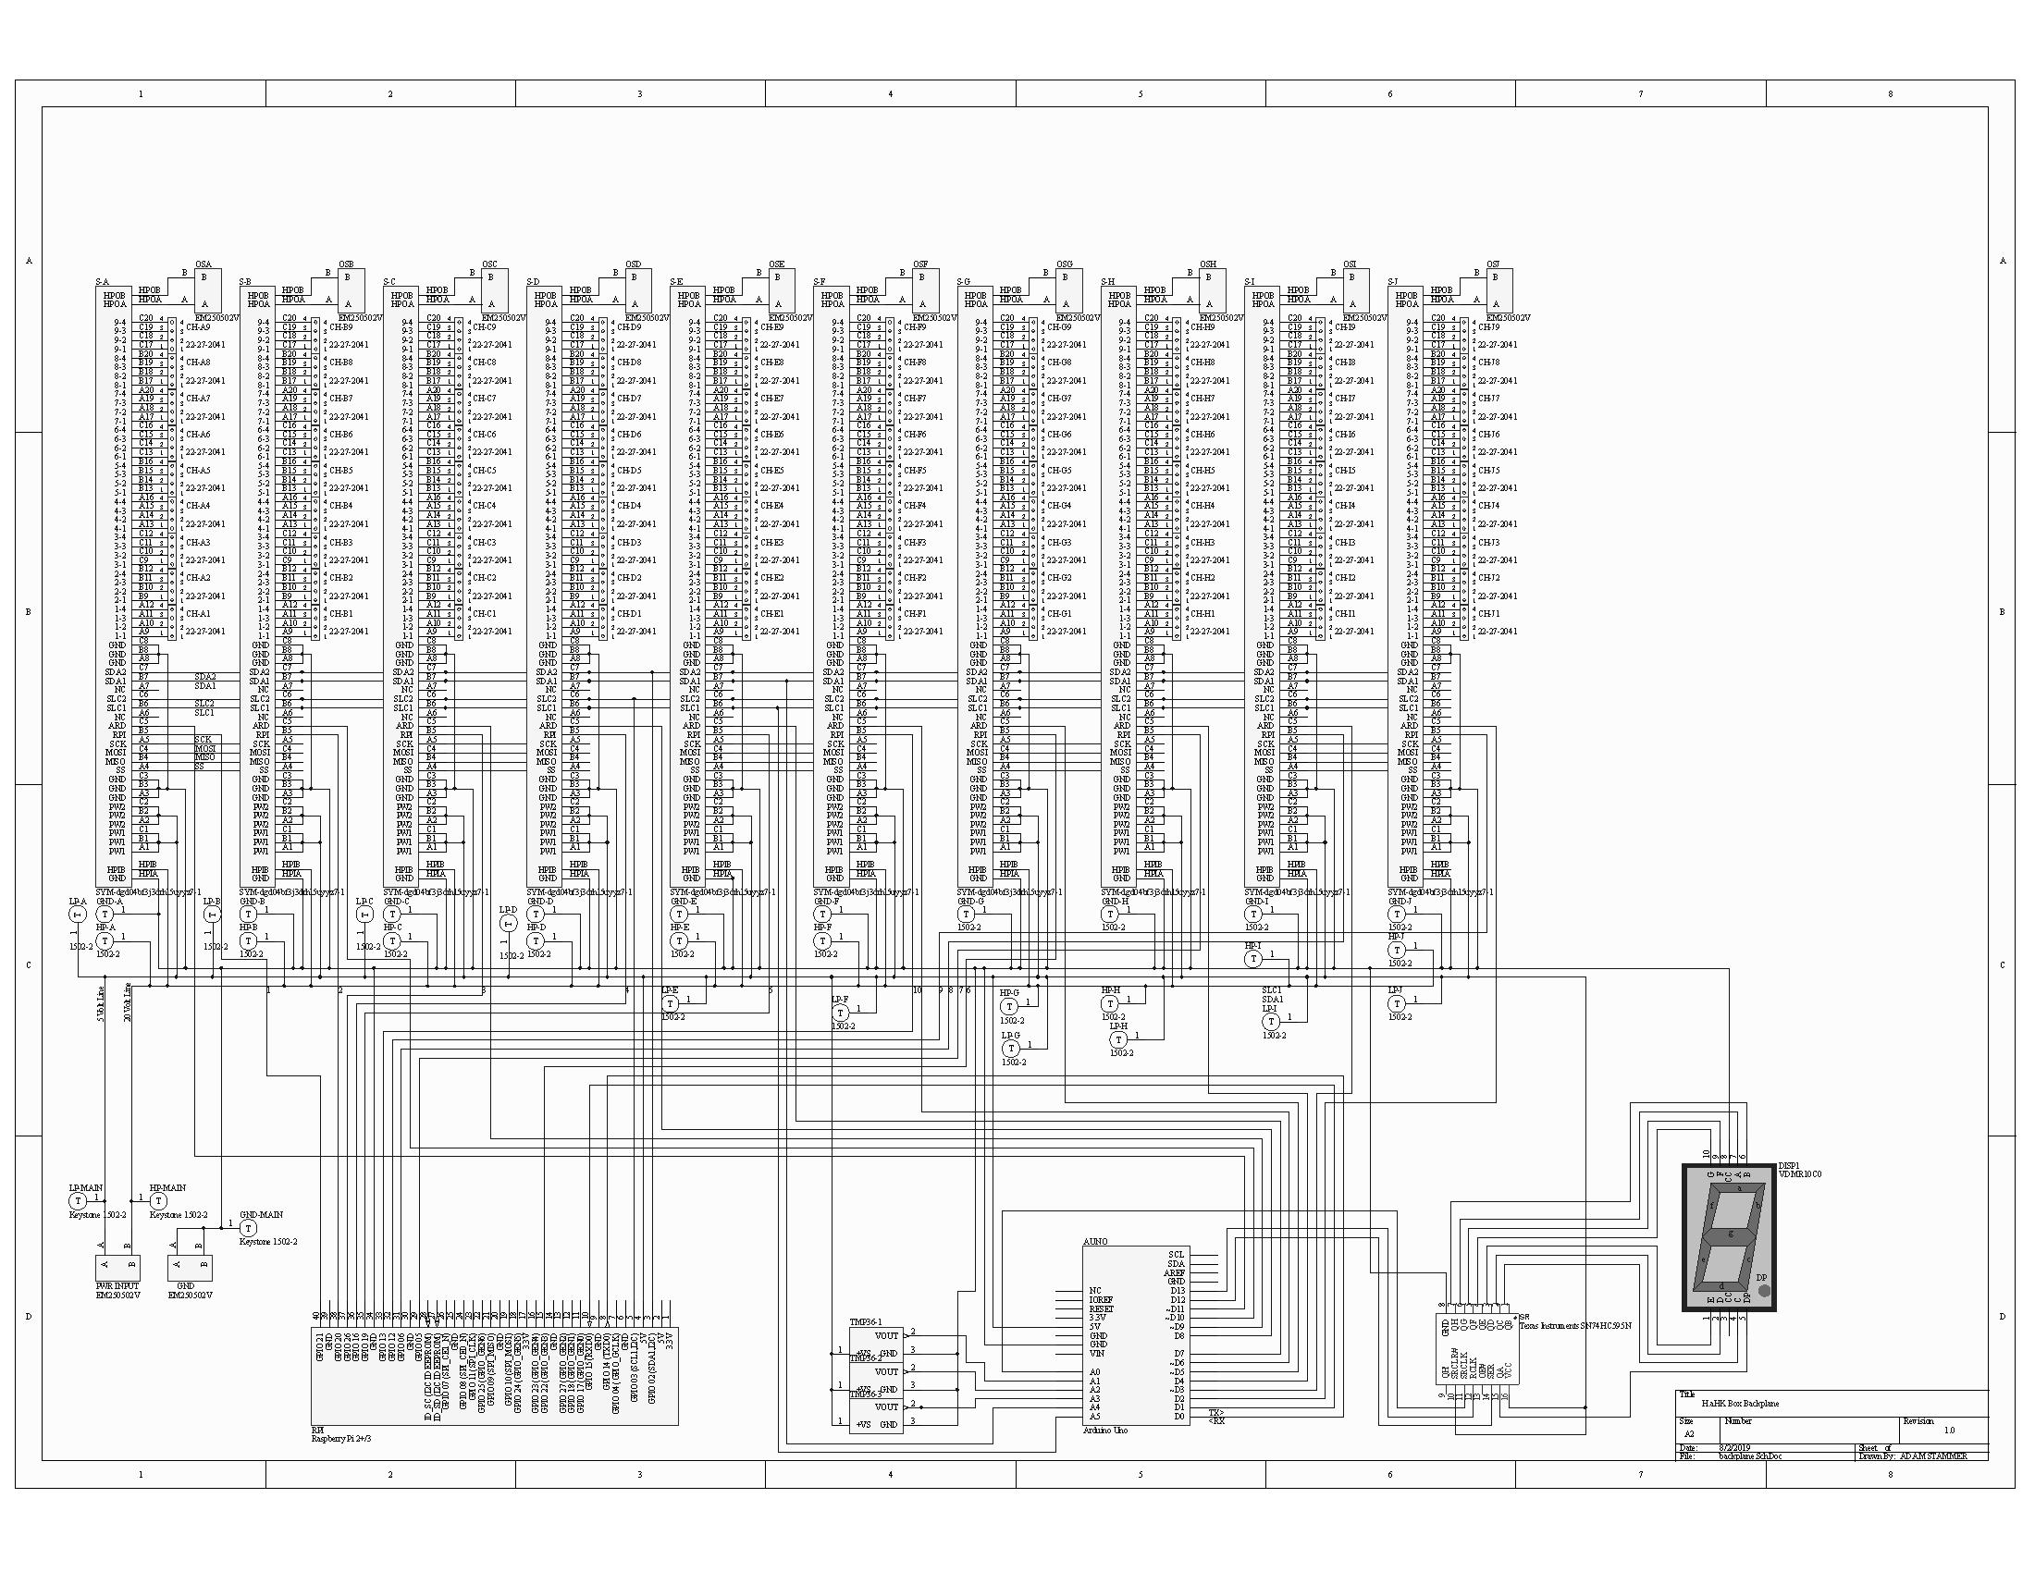
Sockets, Power, SPI, HP Signal I/O, 9 4-pin signal I/Os per card, Arduino Controller (with I2C), On board Temperature Sensors, 7-segment digit display, 5Volt and 20Volt Power, Raspberry Pi (with I2C), Interrupts from Arduino and Pi
Backplane
Schematic

Slide 17
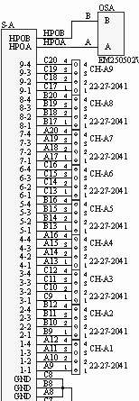
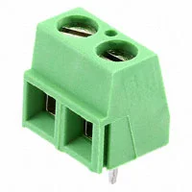
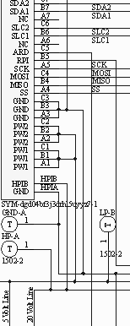
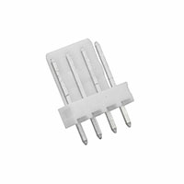
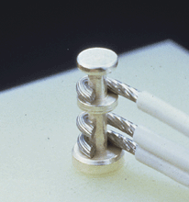
Sockets, Power, SPI, HP Signal I/O, 9 4-pin signal I/Os per card, Arduino Controller (with I2C), On board Temperature Sensors, 7-segment digit display, 5Volt and 20Volt Power, Raspberry Pi (with I2C), Interrupts from Arduino and Pi
Backplane
Schematic
Closeup
A
B
C

Slide 18
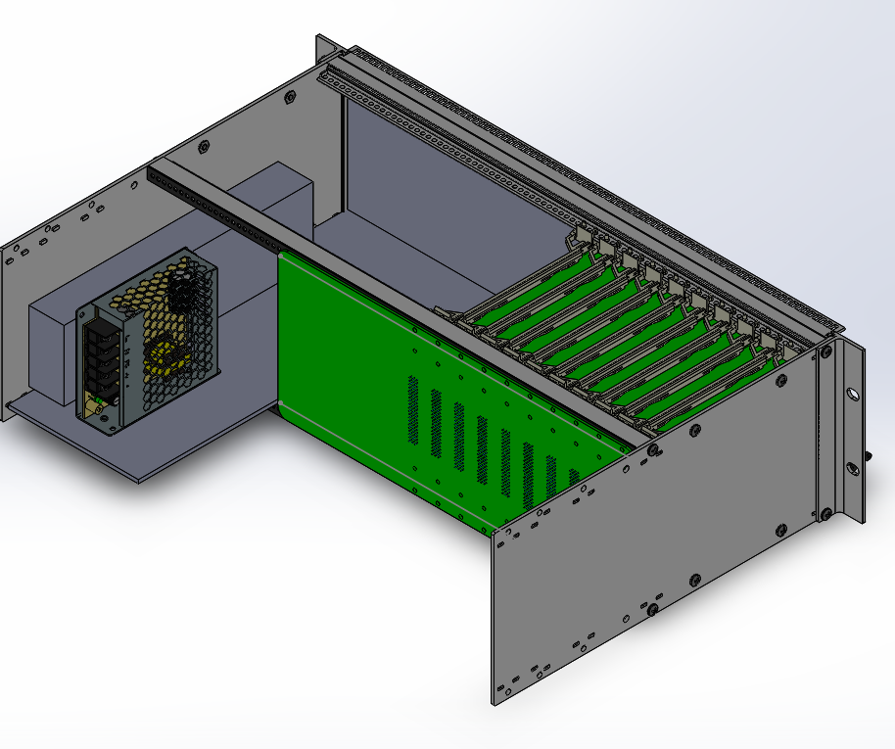
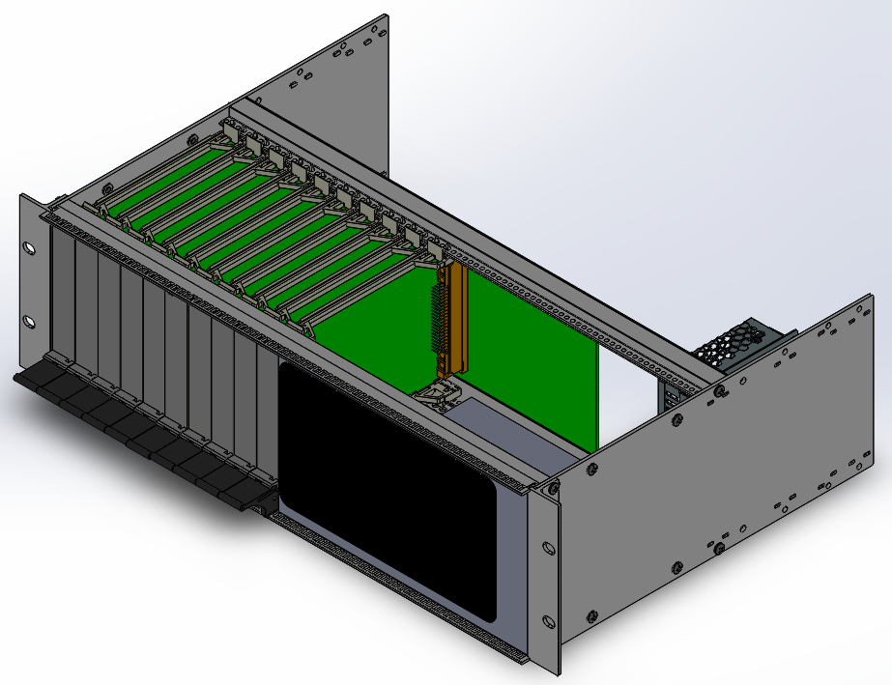
Chassis Render
Front

Slide 19
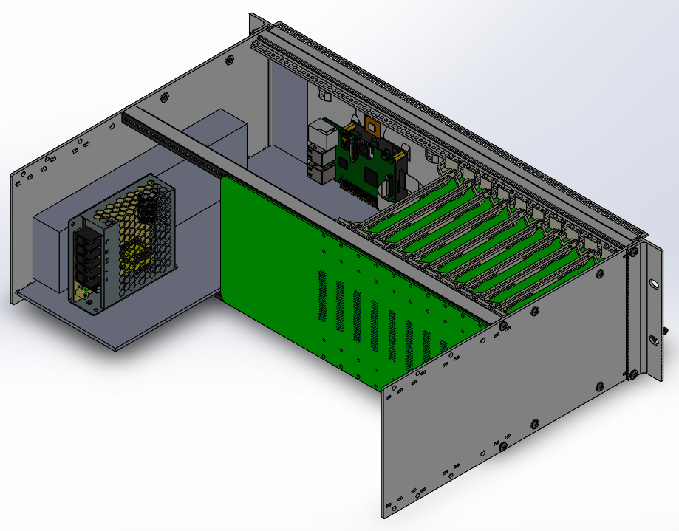
Chassis Render
Back

Slide 20
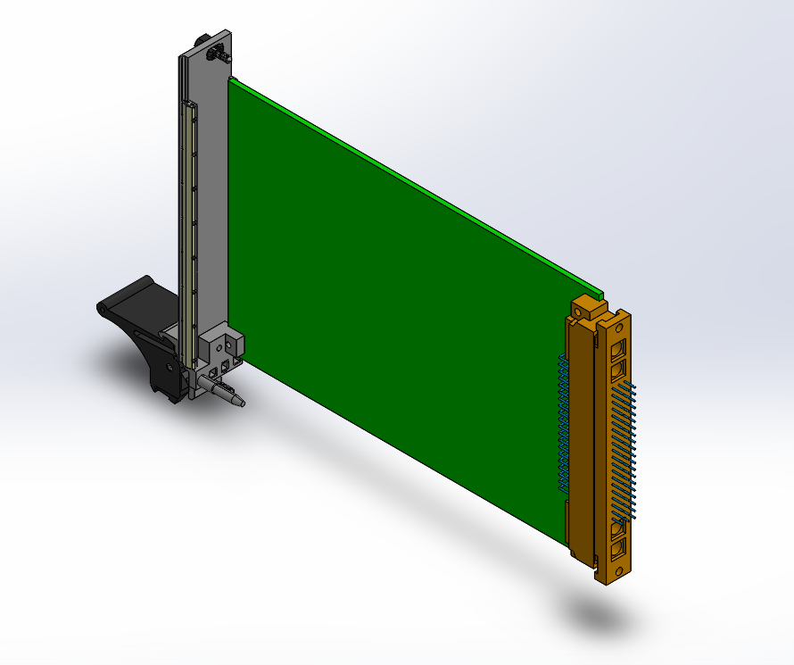
Card Render

Slide 21
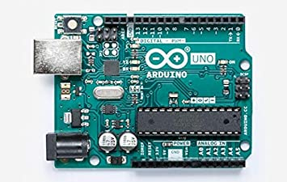
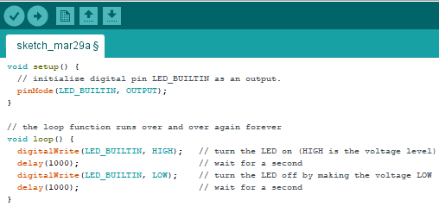
What is a Microcontroller?
Dedicated Single-Task Computers
Small
Low Power
Low Cost
Dedicated Input
Example Uses
Smart Devices
Motor Controller
Thermostat
Remote Control
Microcontrollers

Slide 22
Finish Technical Guide
Summary of Completed Work
Guide Future Designers and End Users
Finish Backplane PCB Layout
Manufacture
Program Controllers
Capacity Tests
Design/Build Cards
Next Steps

Slide 23

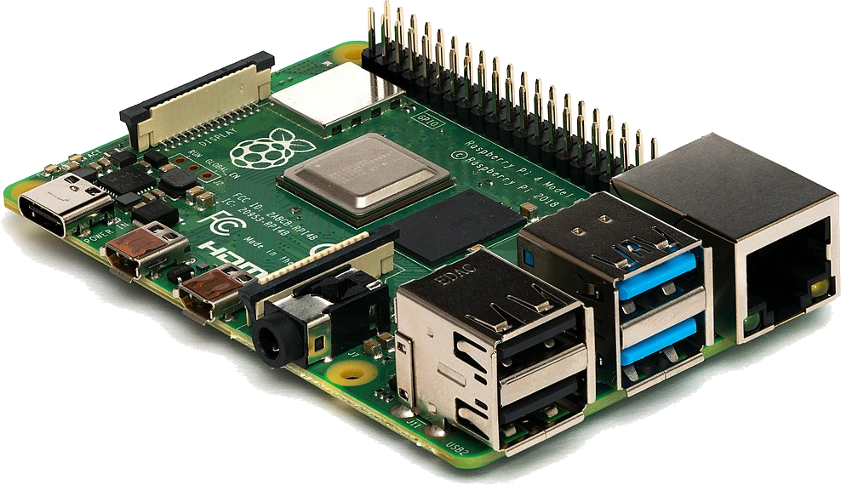

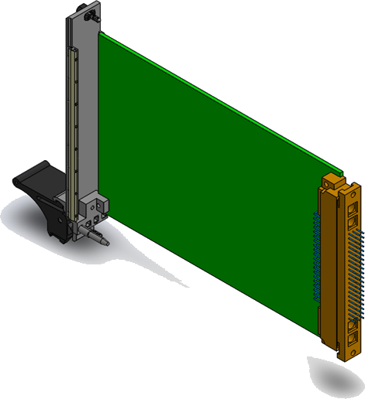
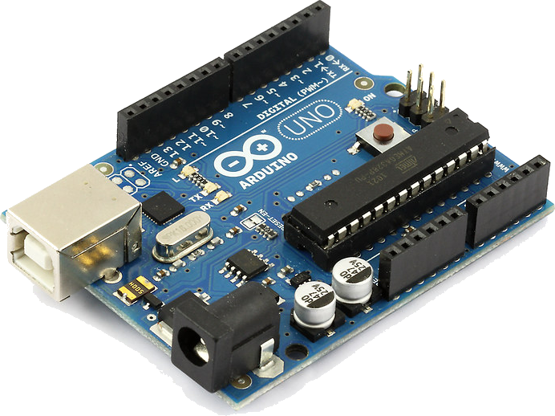

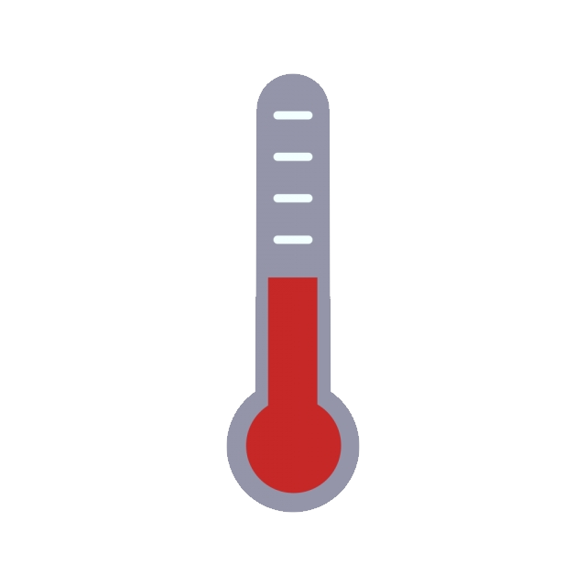
Touchscreen
Raspberry Pi
Microcontrollers
Communication Example
-200°C
Cooler Controller
Arduino
Temperature Sensor
ZEUS2

Slide 24
Purpose
To communicate data between separate pieces of hardware
Components
Data
Timer
Power
Interface
Wire
Circuit Board
Wireless
Active/Passive
Inter/Intra
Shared/Dedicated Bus
Embedded Systems Communication
Protocols

Slide 25
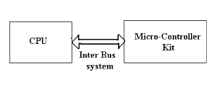
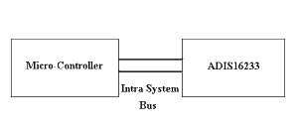
Inter vs. Intra System Communication
Inter – Communication between two separate systems
e.g. Computer to Arduino or Cell Phone
Intra – Communication between two dependent systems
usually on the same circuit board
e.g. Temperature Sensors to CPU on PC Motherboard
Shared vs. Dedicated Bus
Shared – Multiple Devices on the same BUS allows for fewer wires but adds complexity (What happens when two devices talk at the same time?)
Dedicated – Each devices gets it’s own BUS/Data Line
Active vs. Passive
Passive – Common Data Bus written to and read from as necessary (Like holding up a sign)
Active – Always listening on Data Bus for ‘sent’ message (Like Verbal Speech)
Core Considerations

Slide 26
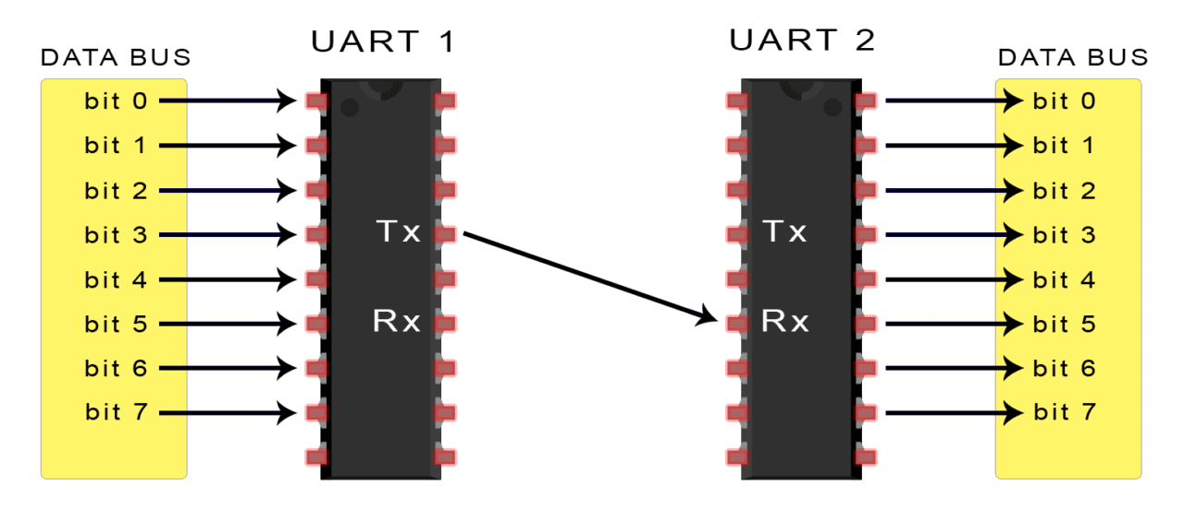
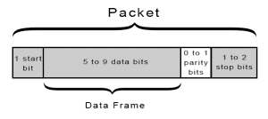
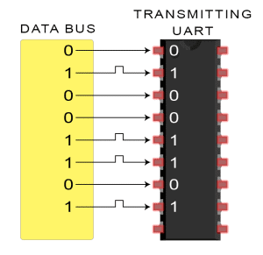
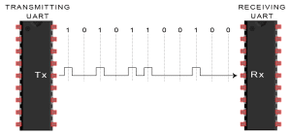
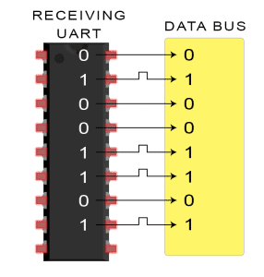
Universal Asynchronous Receive/Transmit
Turn Parallel Data into Successive Data
Advantages
Asynchronous – no clock
Only Uses Two Wires
Transmit (TX)
Receive (RX)
Parity Bit for Error Checking
Disadvantages
One to One Communication
baud Rates must be very similar
Common speed bottleneck
UART
Examples
Predecessor to USB (Mouse and Keyboard)
Arduino Serial Output
Network Equipment

Slide 27
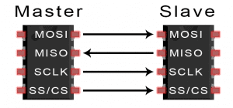
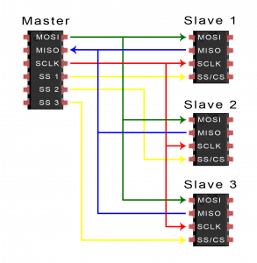
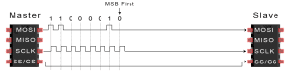
Serial Peripheral Interface
Fast Communication Between One and Many
Designed for computer peripherals
Advantages
Continues (not packet based)
Simple Addressing of Slaves
Very Fast Communication
Separate Send/Receive Lines
One to Many Communication
Disadvantages
4 Wires Required
Clock Signal
Slave Select Even When Unnecessary
No Integrity or Message Received Checks
Only allows for One Master
SPI
Examples
SD Card Readers
Wireless Modules
RFID Readers

Slide 28
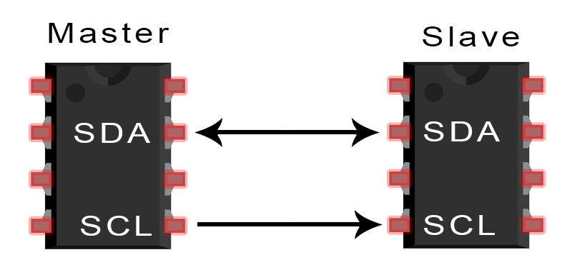
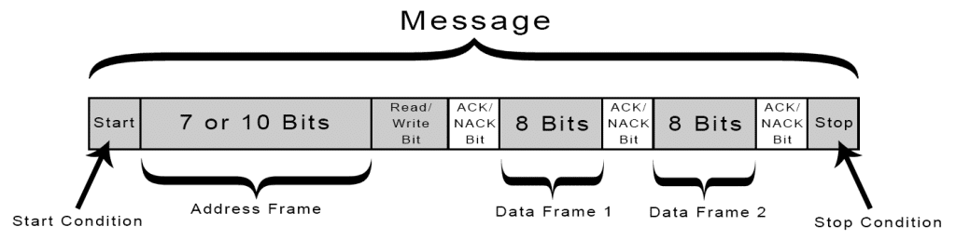
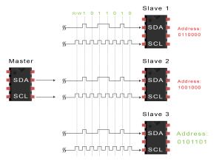
Inter-Integrated Chip
Any Grouping Design But Intended For Many Sensors on the Same Circuit Board
Advantages
Only 2 Wires Regardless of How Many Slaves/Masters
Many to Many Possible
Acknowledgements ensure success
Very Common Protocol
Disadvantages
Not Very Fast
Small Frame Size
High Overhead
I2C, I²C
Examples
OLED Displays
Temperature Sensors
Accelerometer/Gyroscope

Slide 29
Sources
https://www.circuitbasics.com/
https://www.arduino.cc/
https://www.raspberrypi.org/
https://sites.google.com/site/carlferkinhoff/welcome-1 (thanks Carl)
http://hosting.astro.cornell.edu/~spifiweb/zeus2/index.html

